Slide 1

Internship Project Presentation
Employee Management System Website
Internship Guide By:
Mr. Rahul Sharma
Presented by: Harshita Bajiya
Banasthali Vidyapith( Niwai,Tonk)

Slide 2
Points to discuss
Introduction
Technologies
Functionalities
Screenshots

Slide 3
Introduction
Project Name: Employee Management System
Key Features:
Admin Dashboard
Home
About Us
Contact Us
Feedback
Dashboard
Login/SignUp
Project Objective:
User-Friendly application
Role-Based Access Control
Data Validation and Security
Target Users: Employees

Slide 4
Technologies
Frontend
Backend
HTML, CSS, Bootstrap: Techniques are used for the structure of website and media queries are used to ensure the website is accessible and functional across various devices and screen sizes.
React: A powerful JavaScript library for building user interfaces. It allows for efficient component-based development, enabling reusable and interactive UI components.
Axios: A promise-based HTTP client for making API requests from the frontend, facilitating seamless communication with the backend.
Spring Boot Framework: , a powerful Java framework, simplifies the development of robust and scalable backend applications.
Key Features: - Built-in tools for rapid application development.
- Dependency injection for efficient resource management. - Integrated security for authentication and authorization.

Slide 5
Technologies
Authentication and Security
Database
JWT (JSON Web Tokens): Used for secure user authentication and authorization, ensuring that only authenticated users can access certain features and data.
Bcrypt: A library for hashing passwords to ensure that user credentials are securely stored and protected.
MySQL: MySQL is a robust, open-source Relational Database Management System (RDBMS) Features:Ensures data integrity and supports complex queries with Structured Query Language (SQL).
High performance and scalability for large datasets.

Slide 6

Functionalities
User Interface:
Home: General information and login page.
About Us: Static page with organizational information.
Contact Us: Query/message submission form.
Dashboard: Admin-only access for managing employees, attendance, salaries, and feedback.
Feedback Form: Users submit feedback; admins analyze.
Profile: View/edit personal details.
Login/Signup: Secure role-based access.

Slide 7
Functionalities
Admin Interface:
Add or Delete Employees: Admins can add or remove employee from display.
Admin can mark attendance
Admin can Calculate salary of Employee
Admin can create rate for the employee per month
Admin can view dashboard of the employees
Admin can update itself as well as user
Admin can manage company statics
Admin can get attendance summary that number of hours employee worked

Slide 8
Functionalities
Role Based Access Control:
At the time of login If role is found ‘user’ then user will be redirected to home page.
At the time of login If role is found ‘admin’ then user will be redirected to admin dashboard.

Slide 9
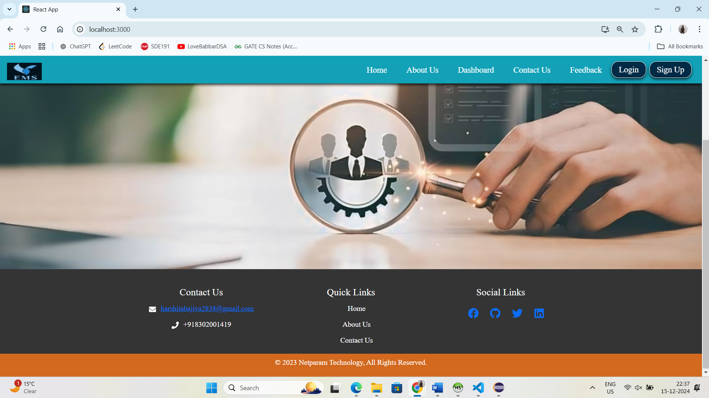
Employee Management System

Slide 10
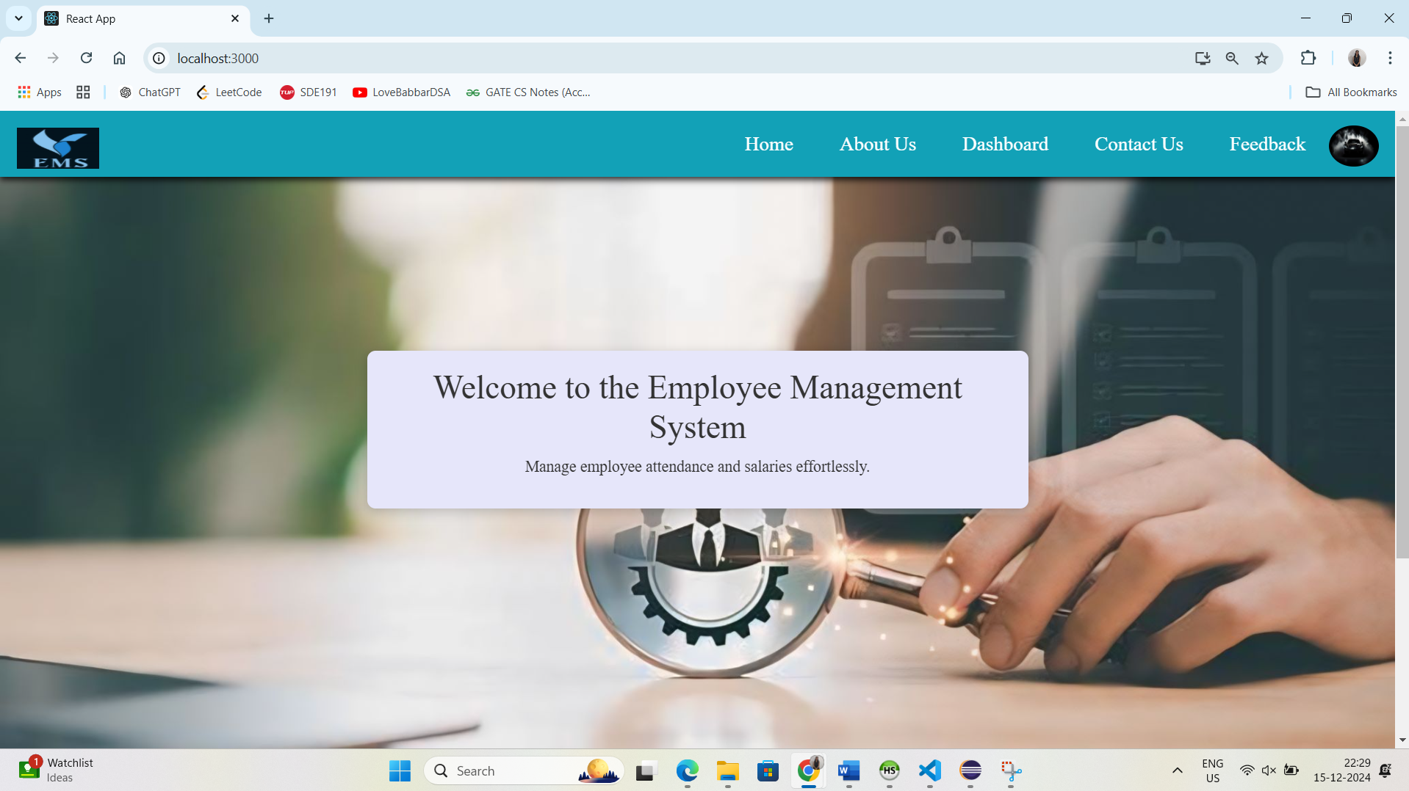
User Interface Screenshots
Home page

Slide 11
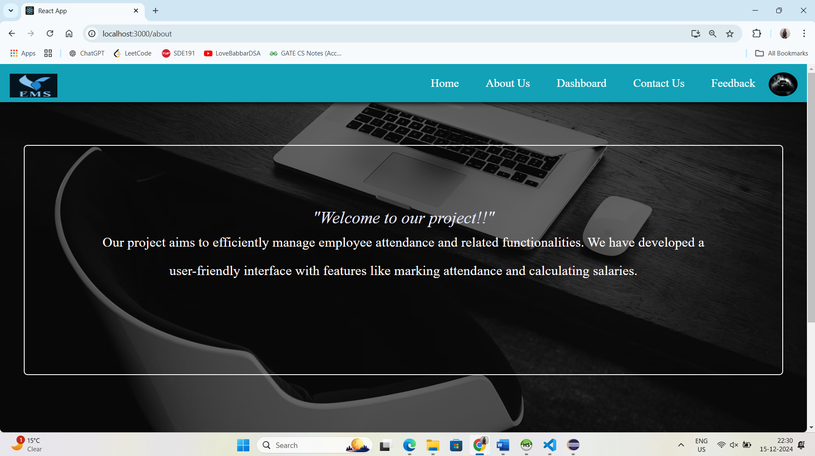
About Us page

Slide 12
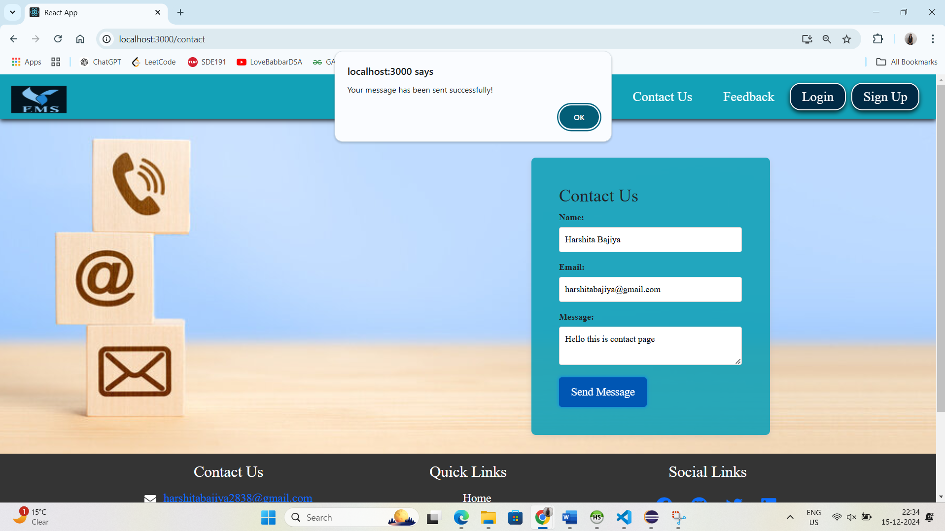
Contact Us page

Slide 13
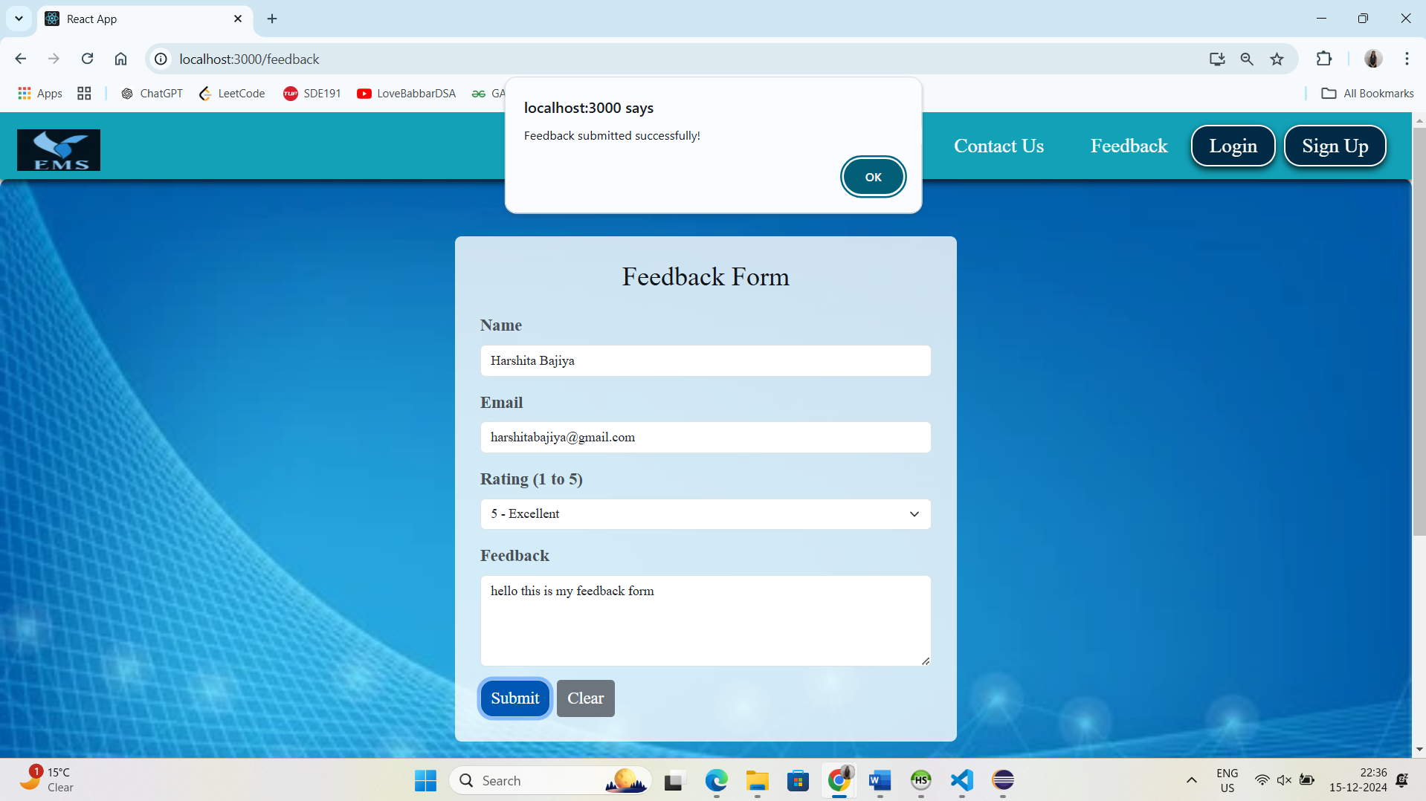
Feedback page

Slide 14
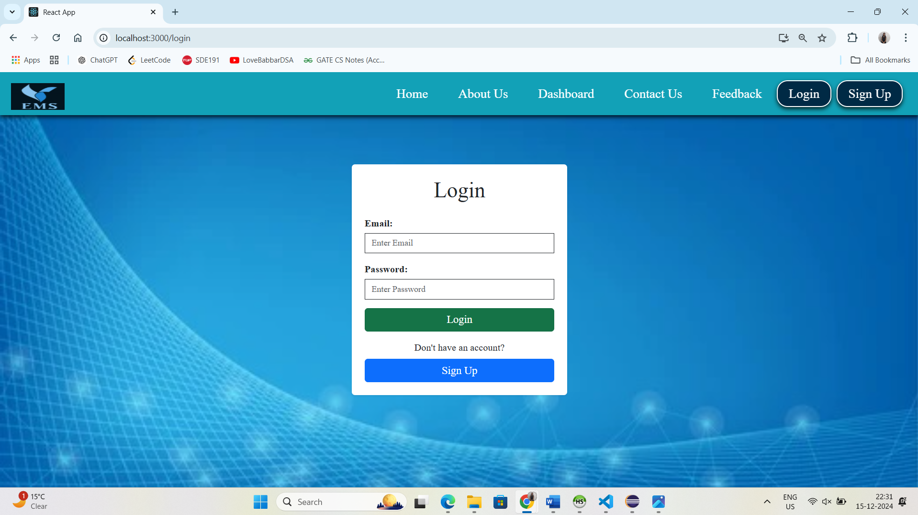
Login page

Slide 15
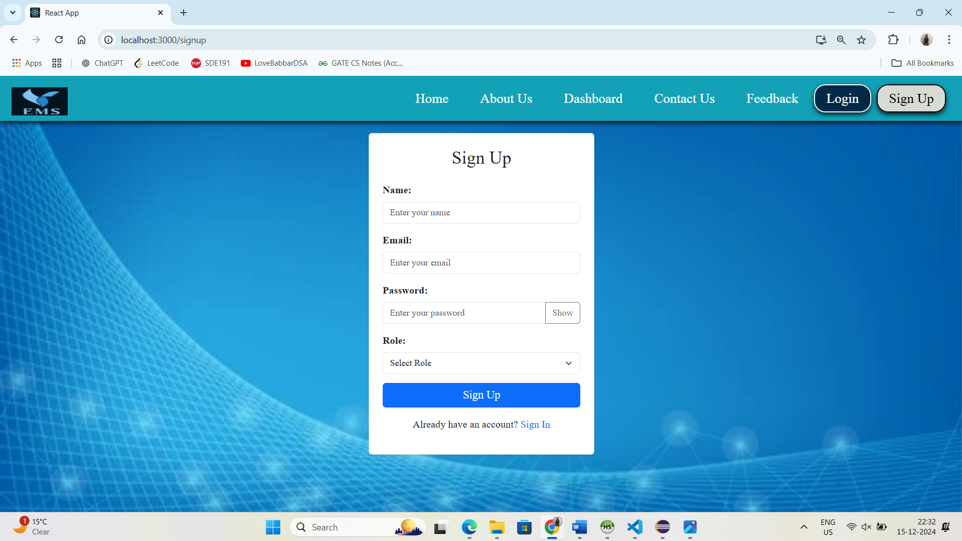
SignUp Page

Slide 16
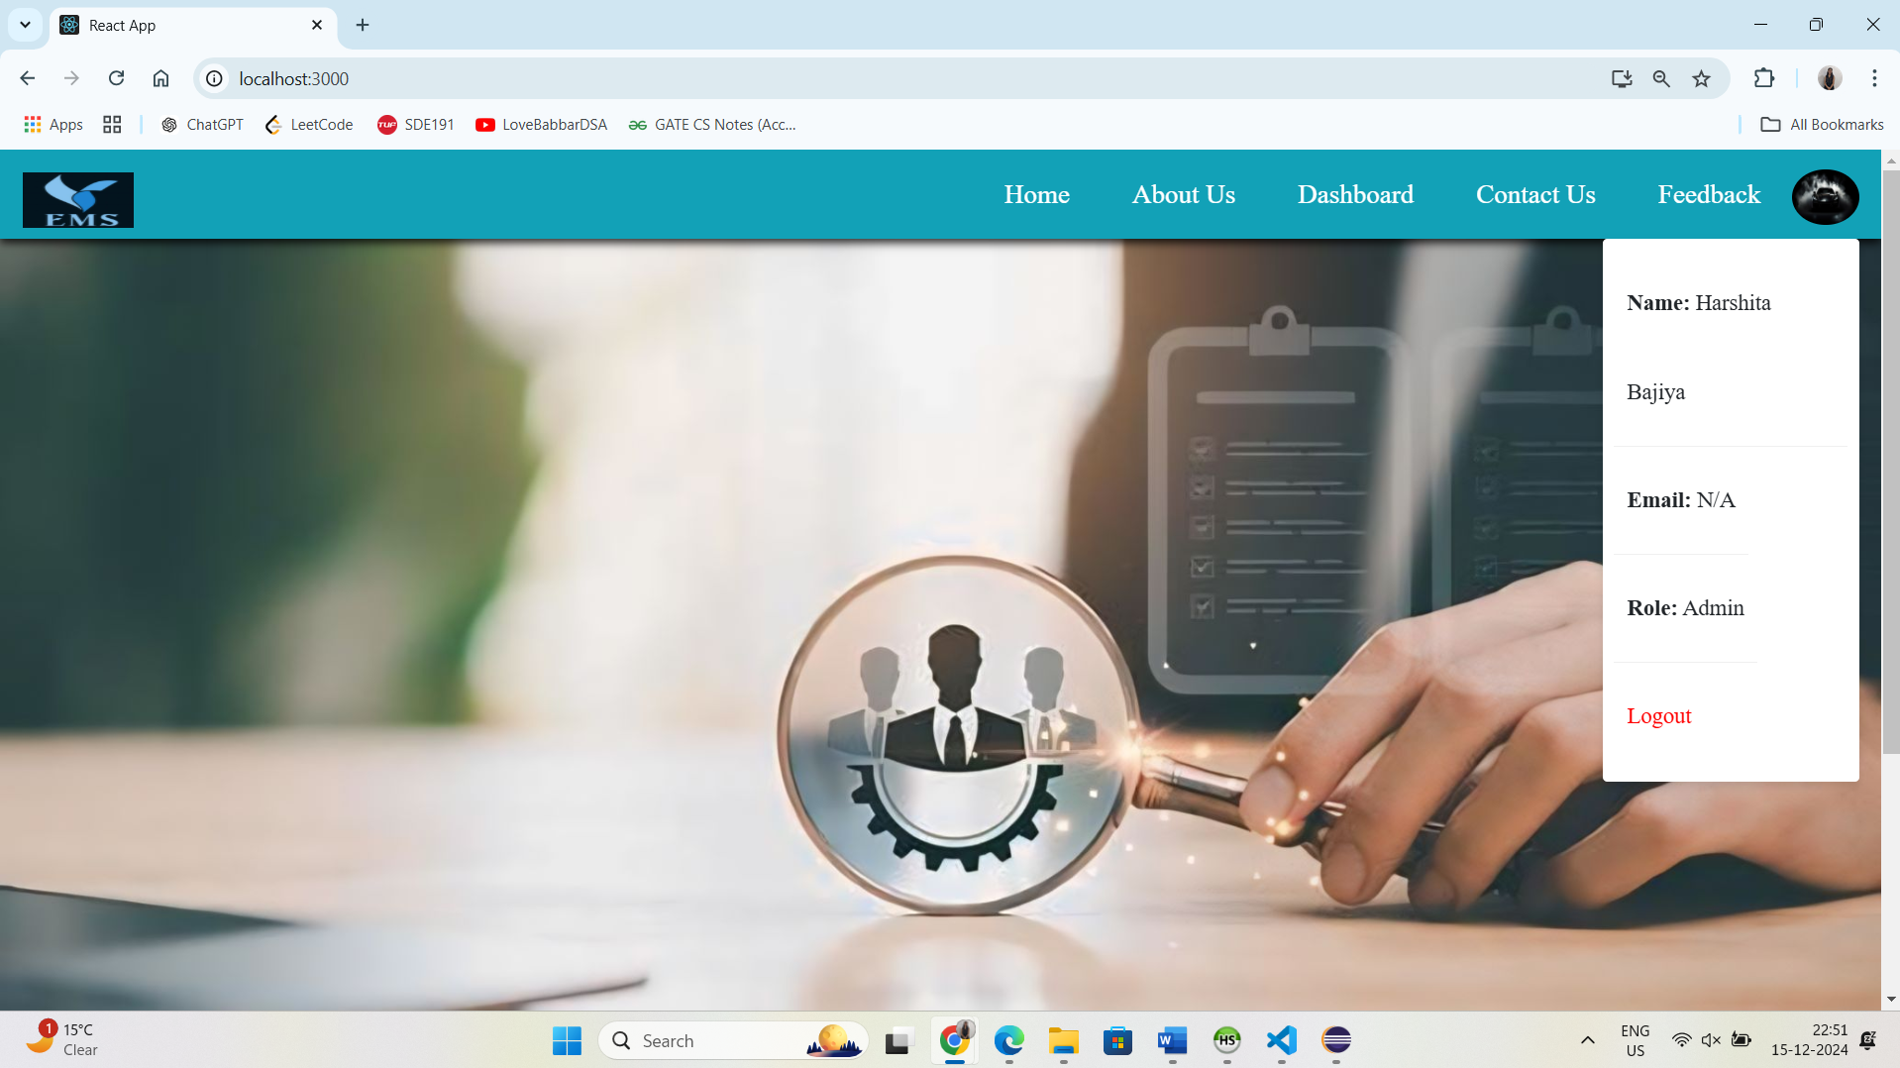
Admin Profile

Slide 17
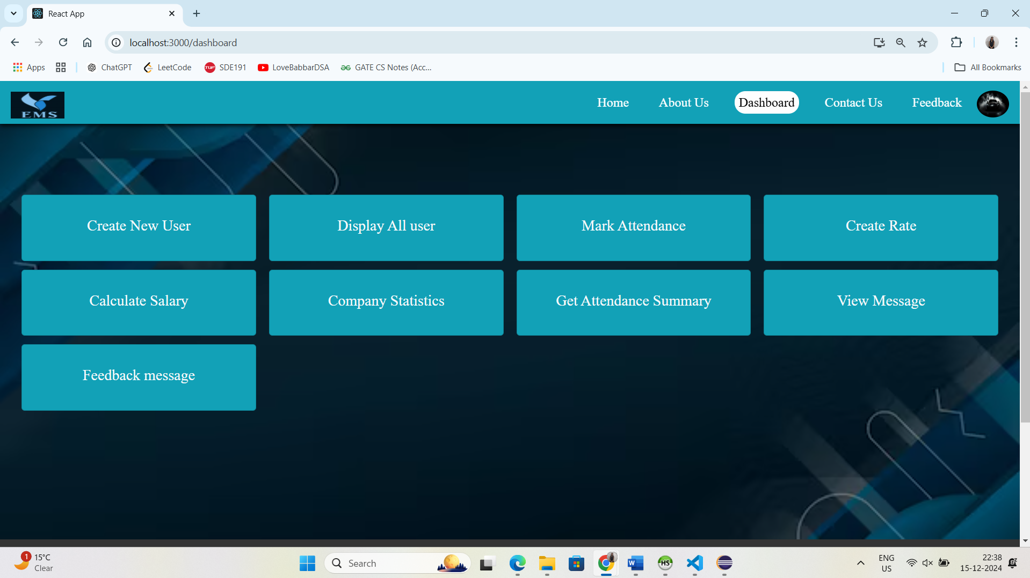
Dashboard

Slide 18
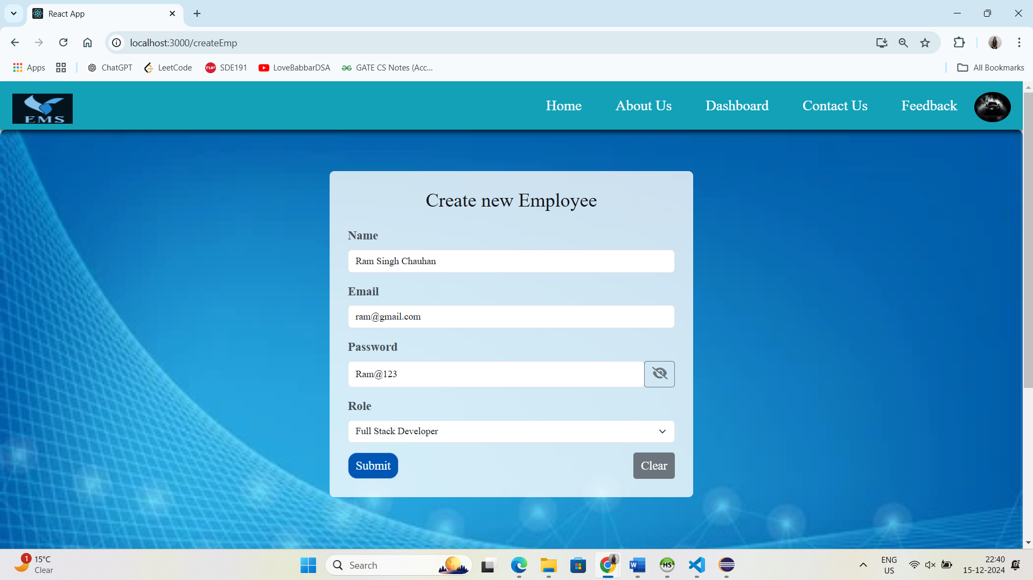
Create New User page

Slide 19
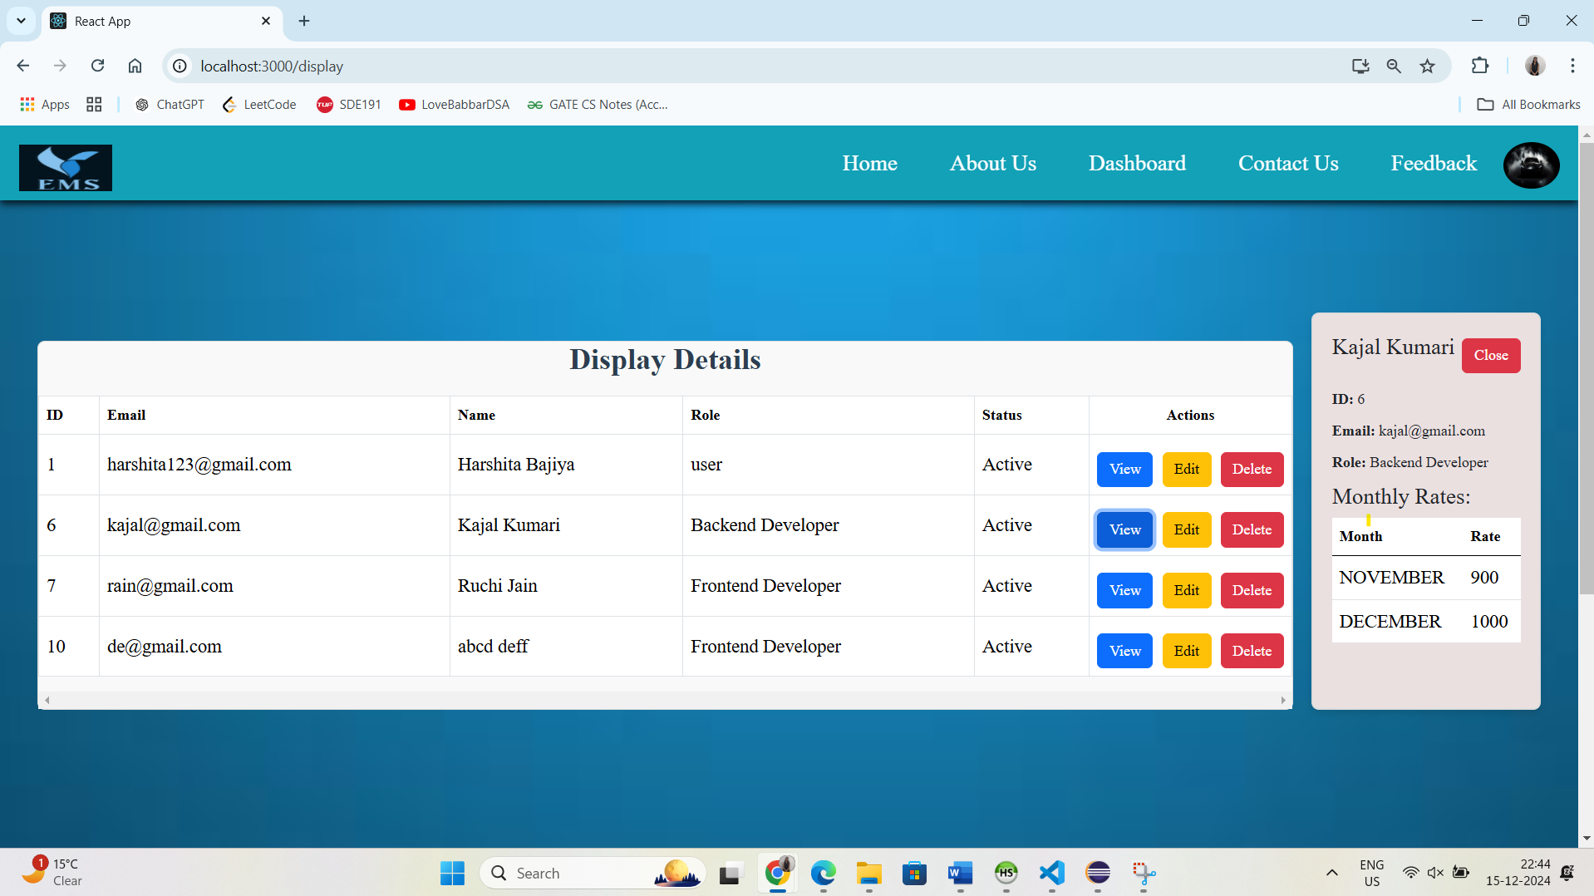
Display All Users

Slide 20
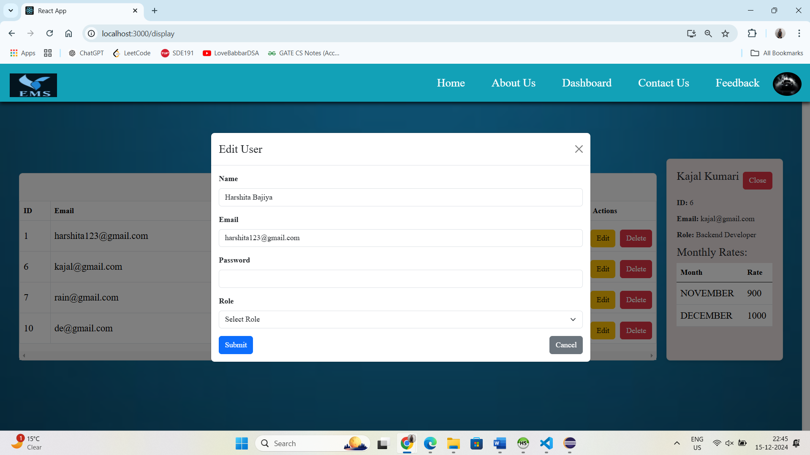
Edit User

Slide 21
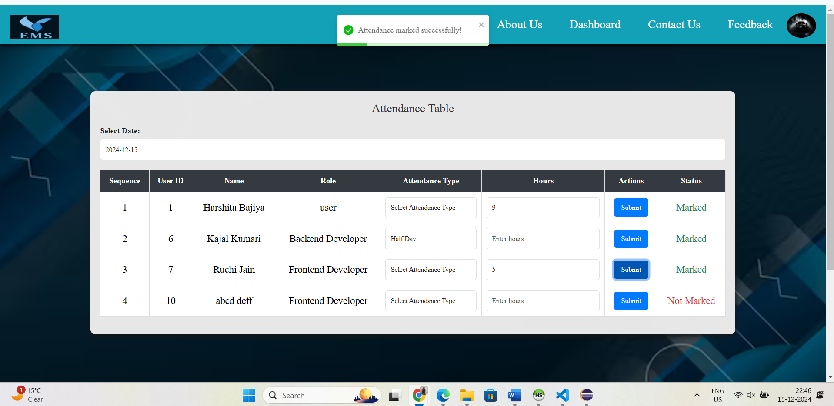
Mark Attendance

Slide 22
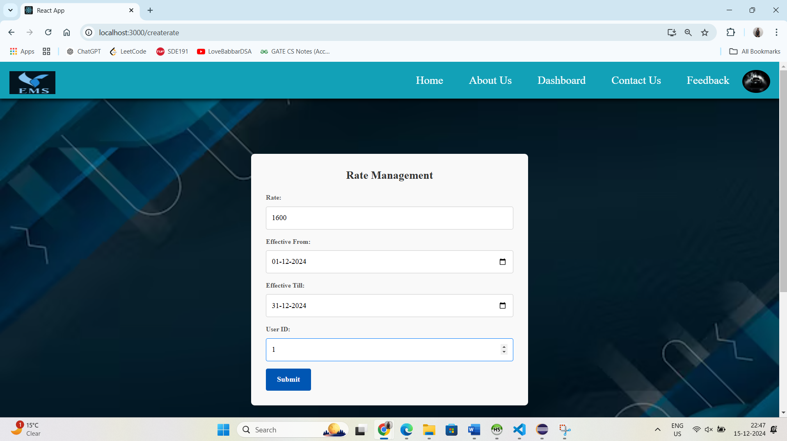
Create Rate for Each Employee

Slide 23
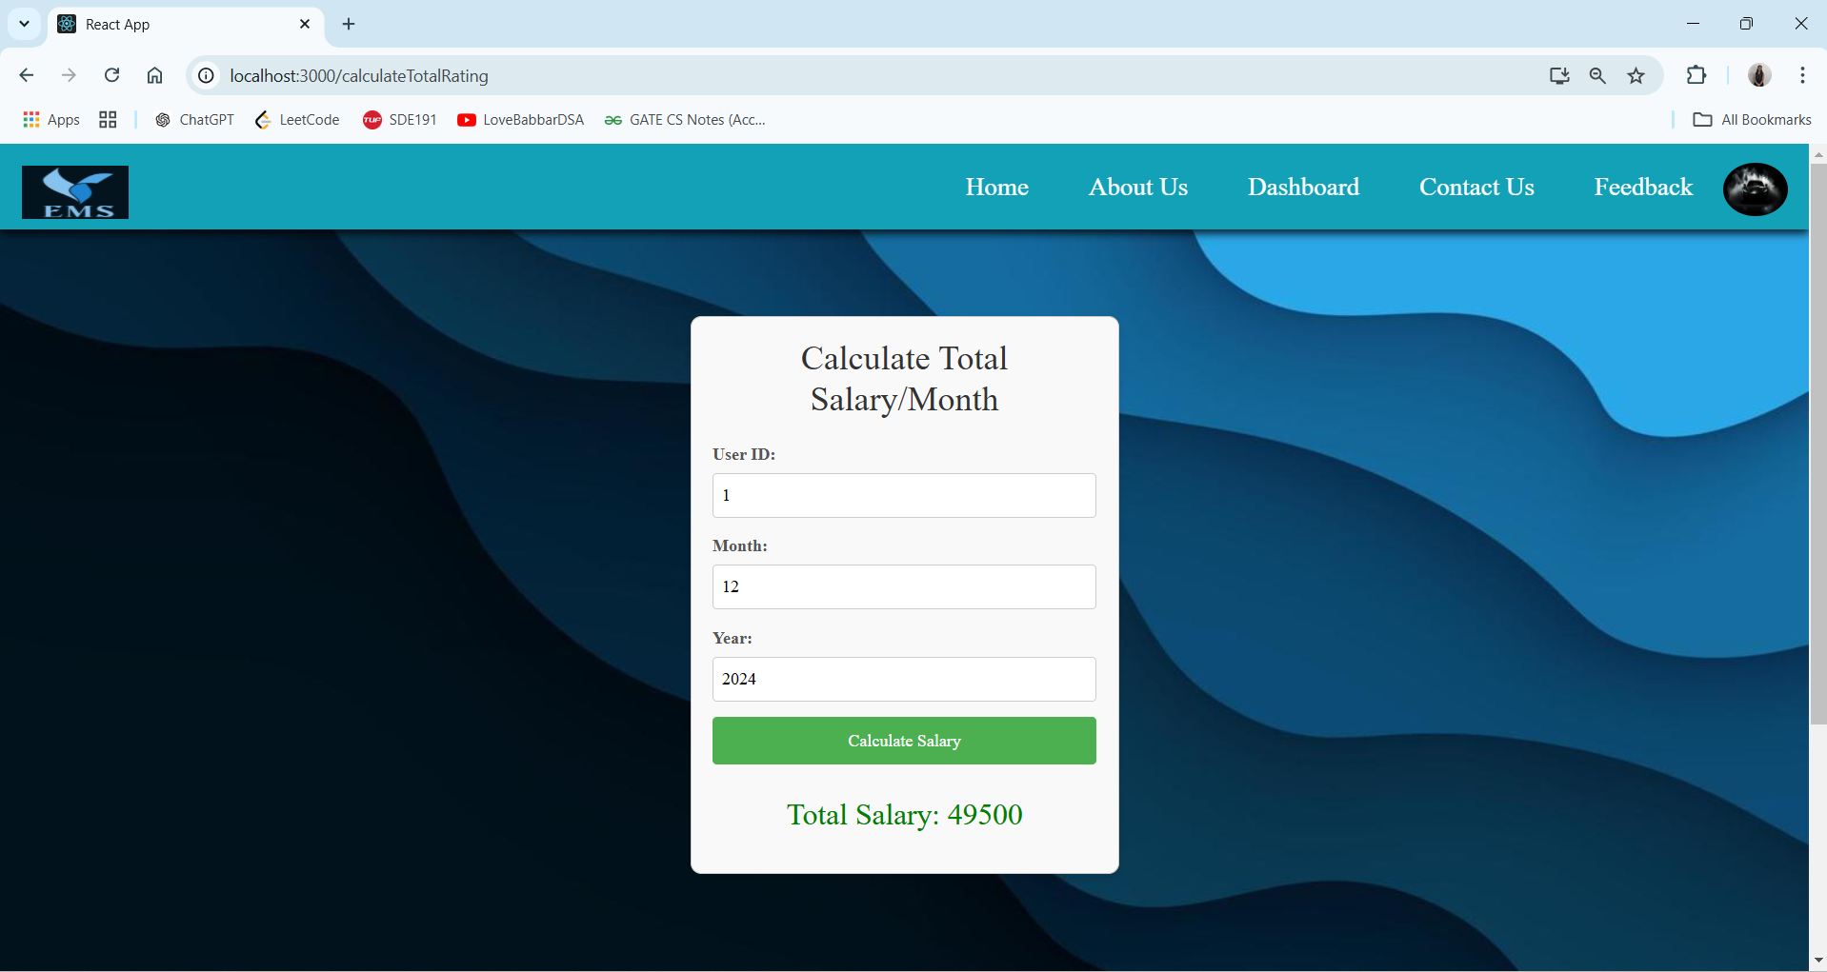
Calculate Salary

Slide 24
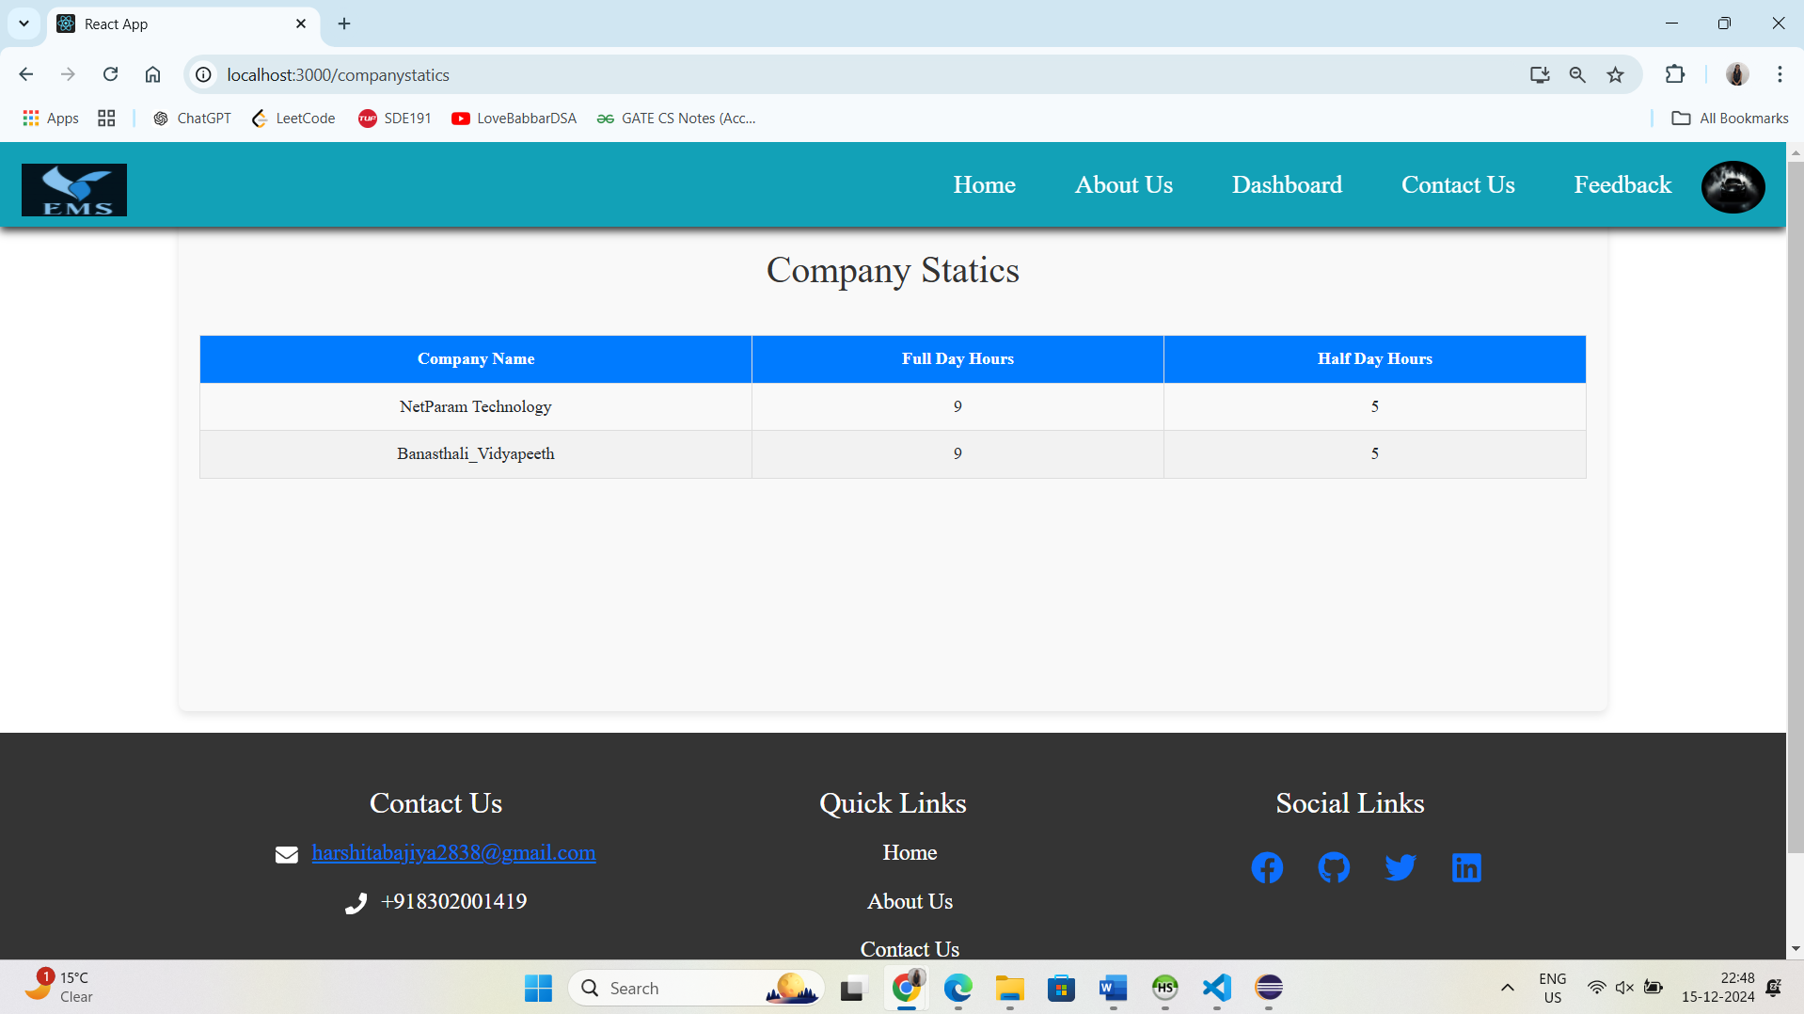
Company Statics

Slide 25
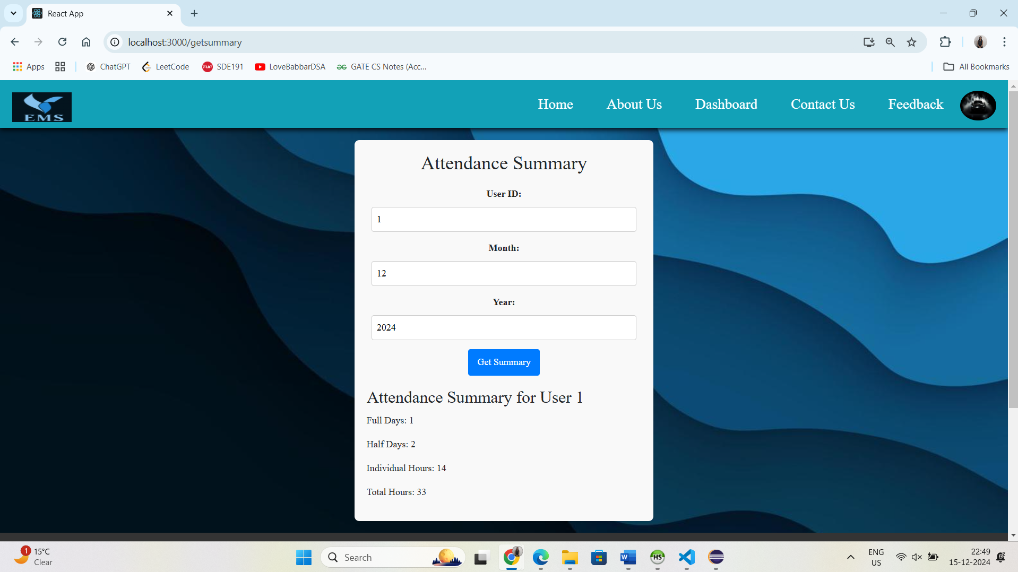
Attendance Summary

Slide 26
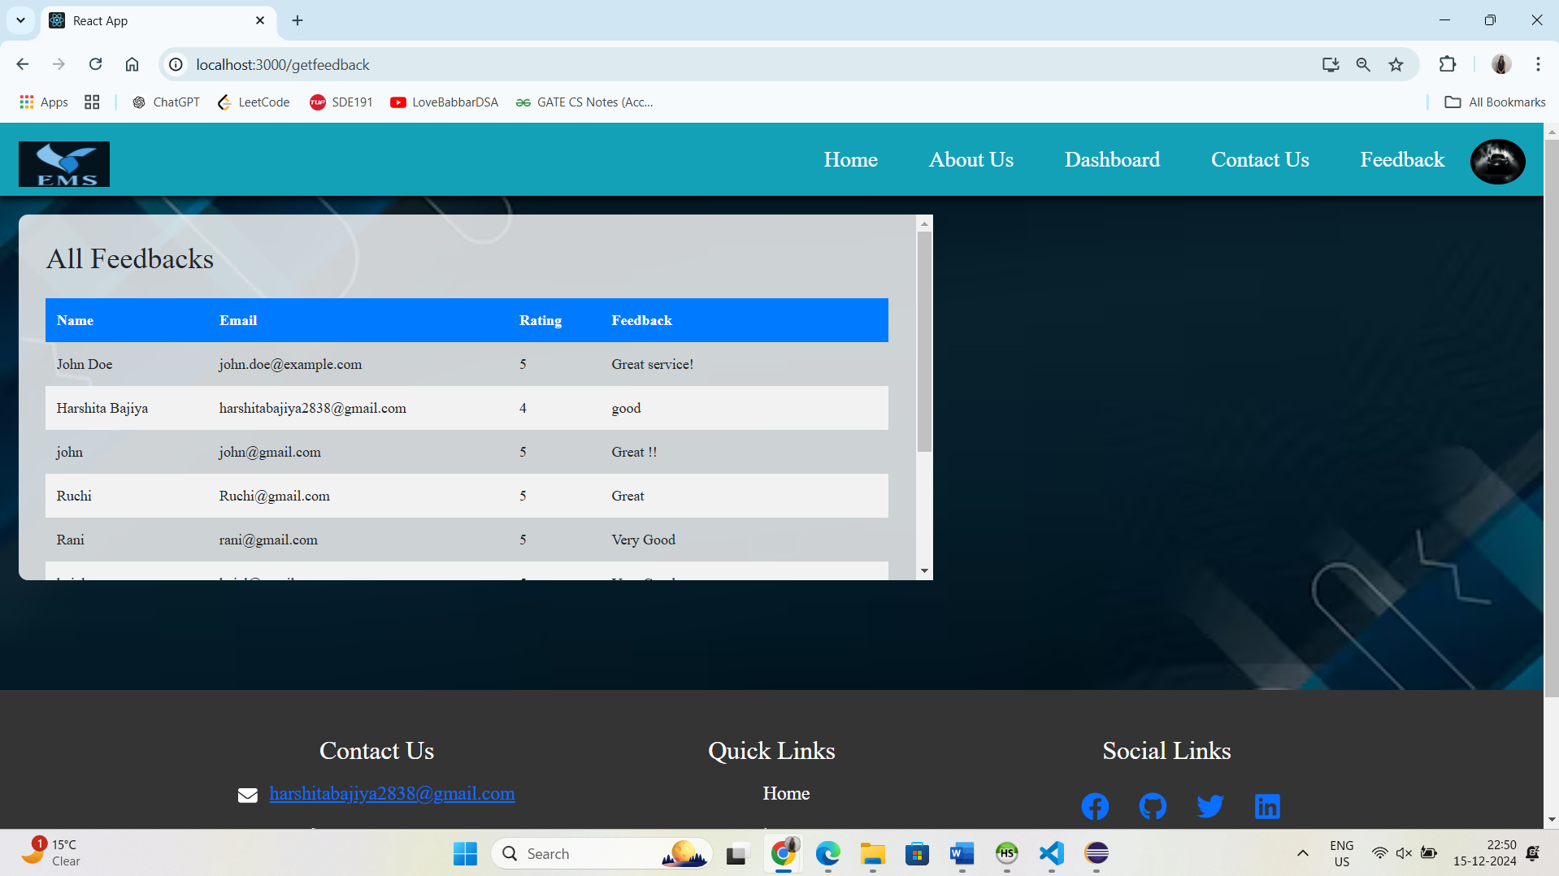
View Feedback message

Slide 27
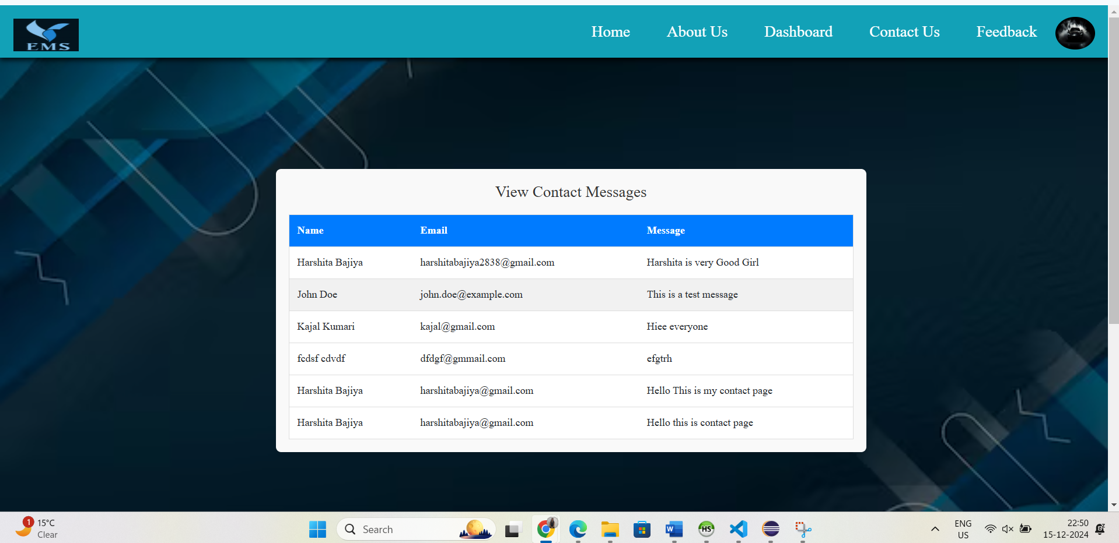
Contact Us Message

Slide 28
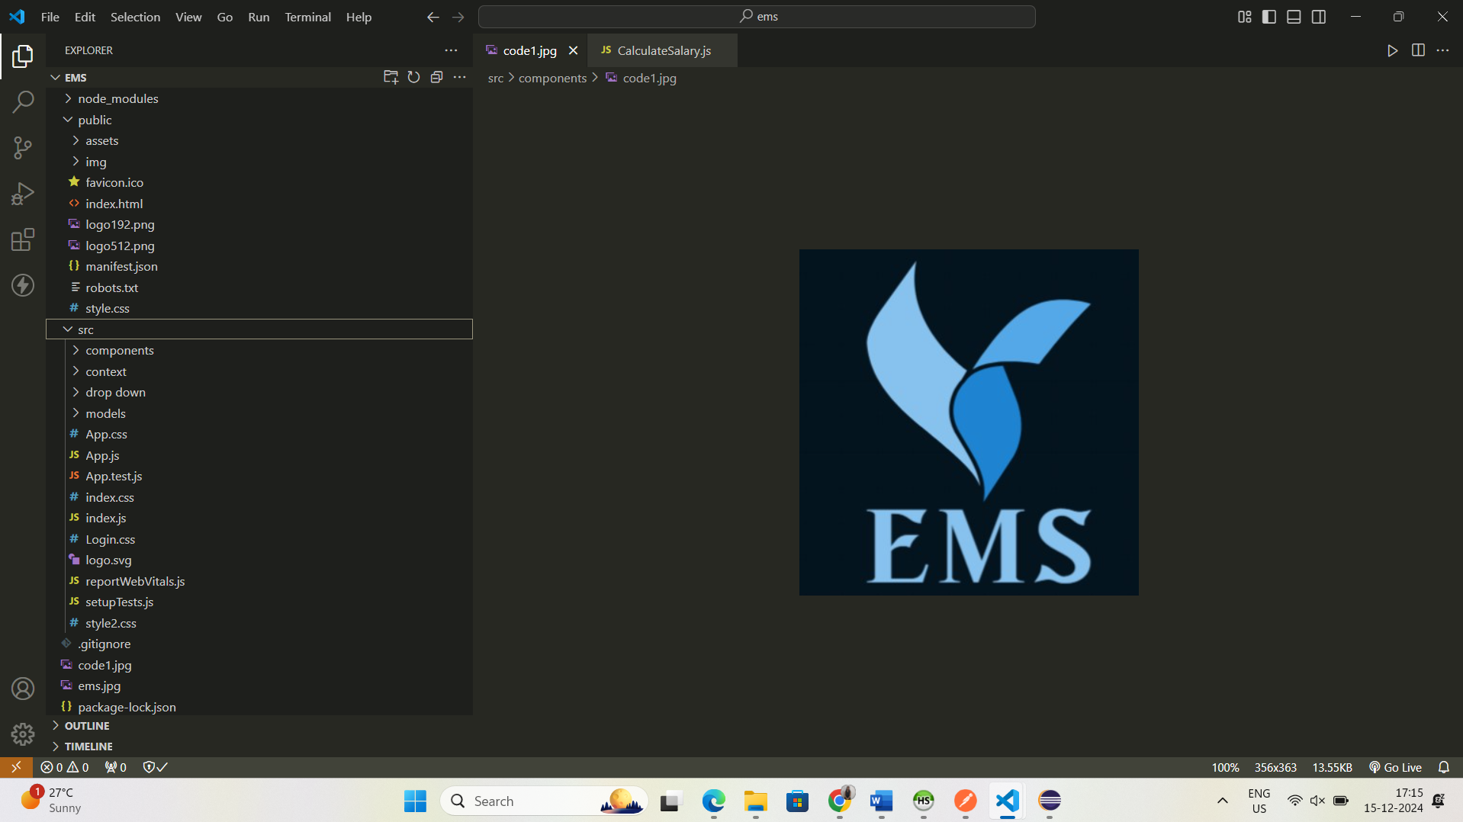
Frontend (React Js Folder Structure)

Slide 29
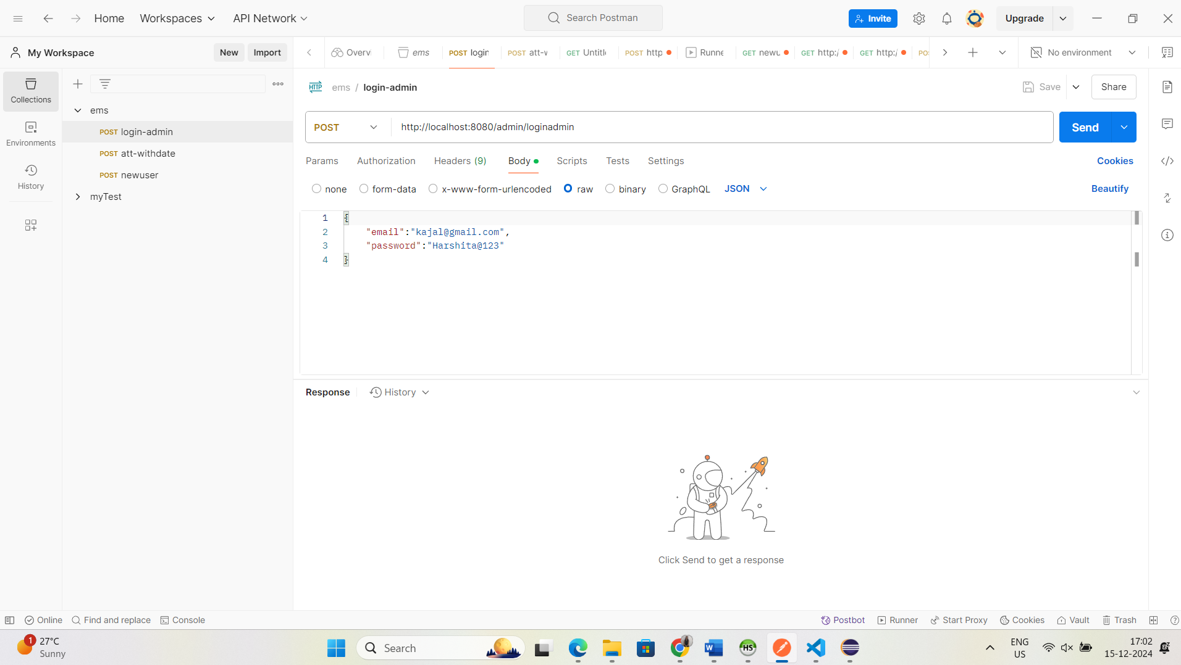
Api Testing (Postman)

Slide 30
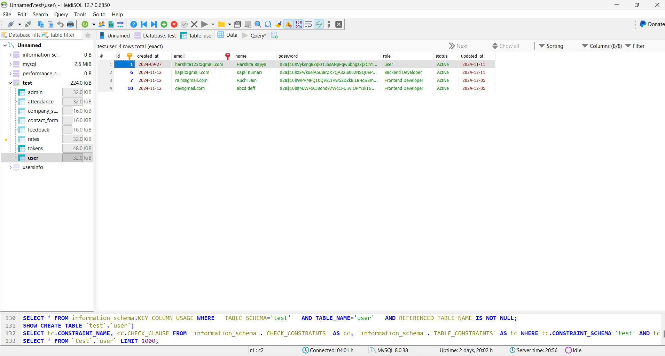
Database(MySQL) -HiediSQL

Slide 31
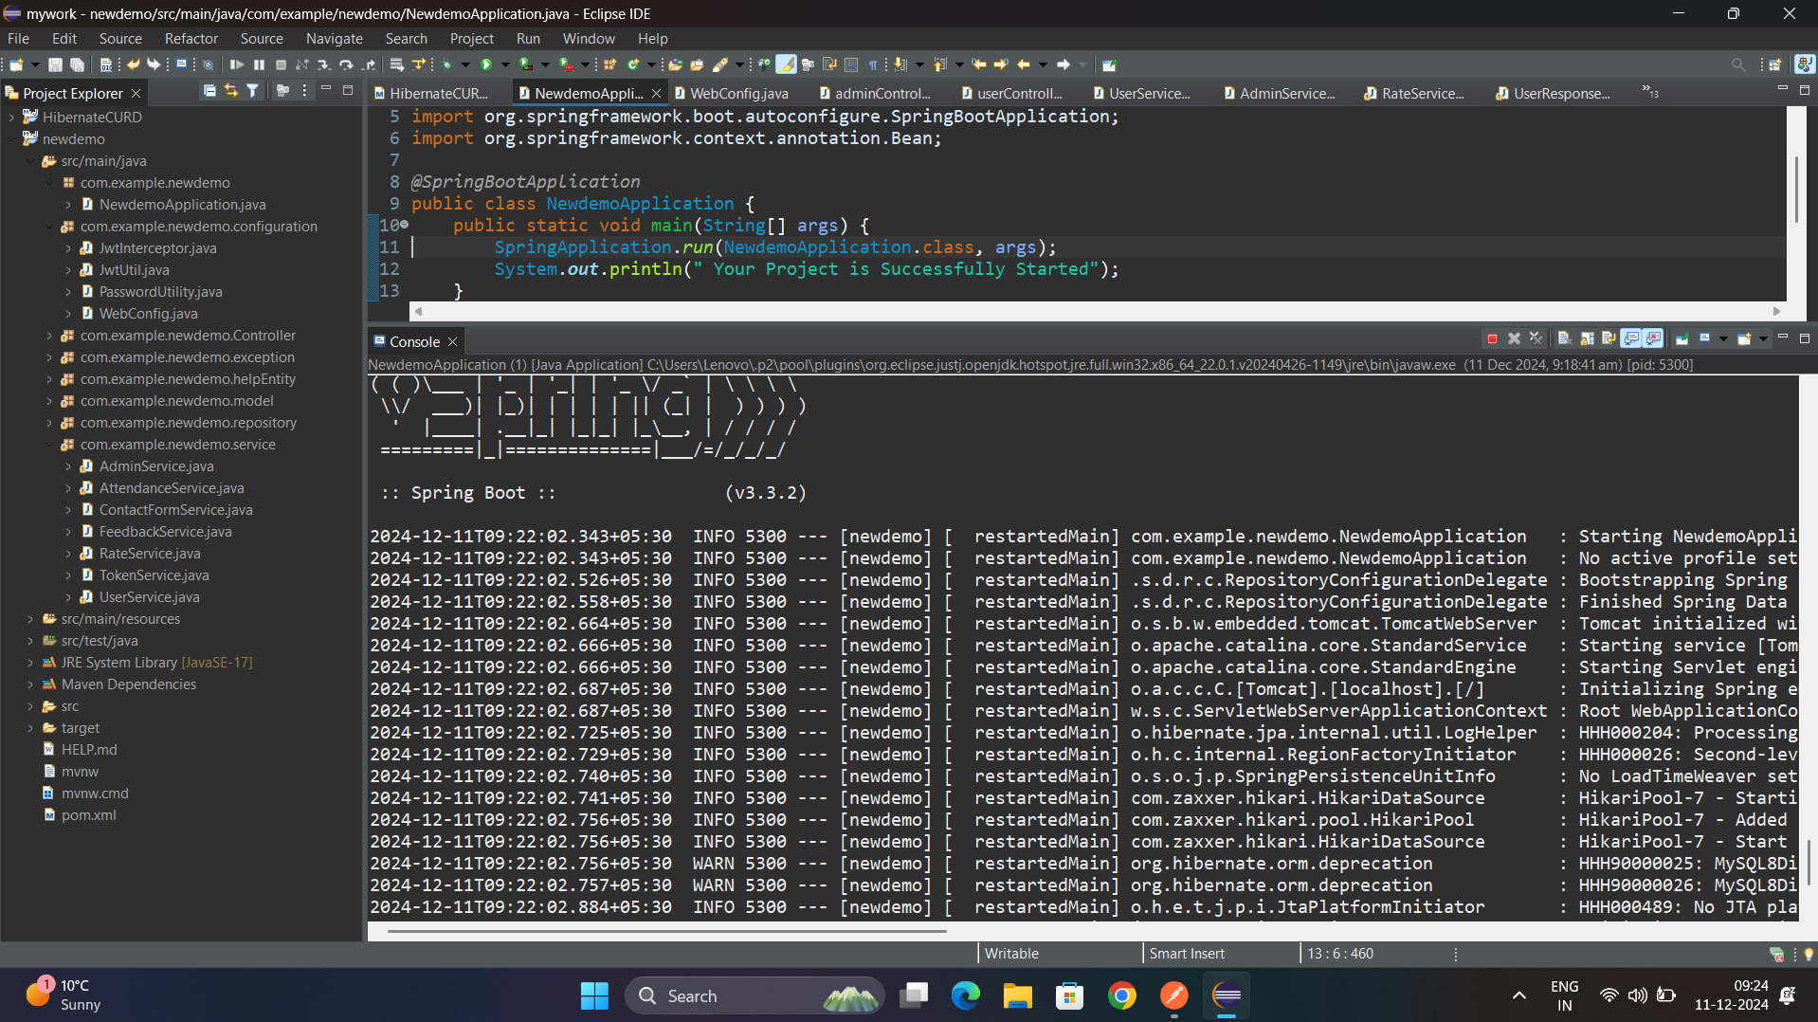
Spring Boot (Backend Folder structure)

Slide 32

THANKYOU!
harshitabajiya2838@gmail.com
HARSHITA BAJIYA

